Slide 1
AF1001 Fundamentals of Accounting (BSE-3rd Semester)
Mr. Sami Ullah
Lecturer NU Fast Peshawar

Slide 2


Slide 3
What is Accounting?
Accounting is the process of:
Recording financial transactions.
Classifying and categorizing these transactions.
Summarizing and analyzing the results.
Reporting on these activities to the relevant stakeholders.

Slide 4
According to the American Accounting Association (AAA), accounting is the process of identifying, measuring and communicating economic information to permit informed judgment and decision by users of the information
Accounting is an information system that identifies, records, and communicates the economic events of an organization to interested users.

Slide 5
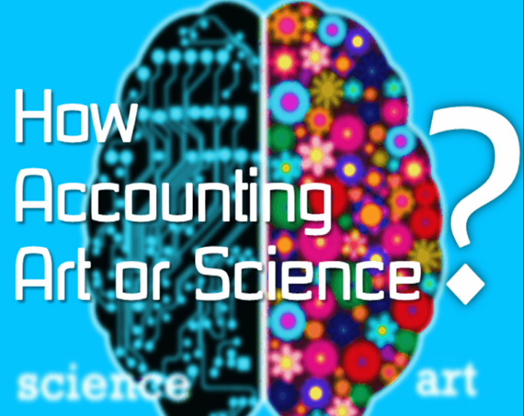

Slide 6
Is Accounting Art or Science?
Accounting is both an art and a science.
It is an art because it involves creative judgment in presenting financial findings in a structured way. It is also an art of recording, classifying and summarizing financial transactions.
Accounting is a science because it is structured knowledge based on certain basic principles. It comprises of rules, principles, concepts, convention and standards

Slide 7
The accounting process
Accounting consists of three basic activities—it identifies, records, and communicates the economic events of an organization to interested users.
Three Activities
As a starting point to the accounting process, a company identifies the economic events relevant to its business. Examples of economic events are the sale of snack chips by PepsiCo, the provision of cell phone services by AT&T (American Telephone and Telegraph Co.), and the payment of wages by Facebook.
Once a company like PepsiCo identifies economic events, it records those events in order to provide a history of its financial activities. Recording consists of keeping a systematic, chronological diary of events, measured in dollars and cents. In recording, PepsiCo also classifies and summarizes economic events.

Slide 8
The Accounting process (Contd.)
Finally, PepsiCo communicates the collected information to interested users by means of accounting reports. The most common of these reports are called financial statements. To make the reported financial information meaningful, PepsiCo reports the recorded data in a standardized way. It accumulates information resulting from similar transactions.
For example, PepsiCo accumulates all sales transactions over a certain period of time and reports the data as one amount in the company’s financial statements. Such data are said to be reported in the aggregate. By presenting the recorded data in the aggregate, the accounting process simplifies a multitude of transactions and makes a series of activities understandable and meaningful.
A vital element in communicating economic events is the accountant’s ability to analyze and interpret the reported information.
Analysis involves use of ratios, percentages, graphs, and charts to highlight significant financial trends and relationships. Interpretation involves explaining the uses, meaning, and limitations of reported data.

Slide 9
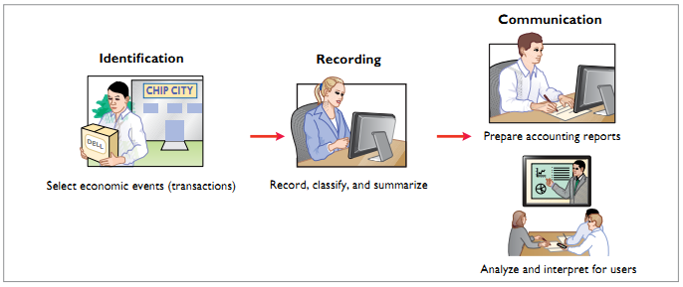
Illustration 1.1 Activities in accounting process

Slide 10
Purpose of Accounting:
The purpose of accounting is to:
Accumulate and report financial information about a business.
Help stakeholders and shareholders make rational decisions.
Provide information about a company's results of operations, financial position, solvency, liquidity, cash flows, and other economic information.
Assist managers in making decisions related to operations, investments, and other activities necessary for running the business successfully.
Record and report a company’s financial transactions, financial performance, and cash flows.
The main purpose of accounting includes to prepare end of the period financial statements includes: Balance sheet, income statement, cash flows statement, owners equity statement, and retained earning statement etc.

Slide 11
Functions of Accounting
Recording: Recording of economic information which is of financial character is the primary function of financial accounting. It involves analyzing individual business transaction as and when it occurs, such as, what has taken place? Identifying the nature of account that involves. Ascertaining the rules of debits and credits etc. After the business transactions being analyzed, they are to be recorded systematically in a book called the book of original entry. The whole process of recording a business transaction is called Journalizing. When used separated journals, they are referred as subsidiary journals.

Slide 12
Functions of Accounting Contd.
Classifying: Classifying of financial information is concerned with systematic analysis of the recorded data. It involves posting of journalized transactions in the concerning ledger accounts by grouping them into the accounts that are of similar nature and balancing thereof. It is worth mentioning here, the advent of computers has aided this process significantly. Ledger accounts are balanced automatically when using a particular program developed for financial accounting purpose.

Slide 13
Functions of Accounting (Contd.)
Summarizing: The transactions, having been posted and classified in accordance with the concerning ledgers, are then summarized in a particular manner in order to prepare the following statements. Trial Balance, Income Statement and Balance sheet.
Interpreting/Analyzing: This function involves analysis and interpretation of financial data. Since accounting is regarded as a business language, it provides necessary and the required information to its users through which the profitability and the financial position of a business may be ascertained, which in turn will be very much useful for planning and establishing various policies.
Communicating: After having been analyzed and well interpreted, the financial information is communicated to the intended users.

Slide 14
The primary objective of accounting is to provide information that is useful for decision making purposes. From the very start, we emphasize that accounting is not an end, but rather it is a means to an end.
The final product of accounting information is the decision that is enhanced by the use of that information, whether the decision is made by owners, management, creditors, governmental regulatory bodies, labor unions, or the many other groups that have an interest in the financial performance of an enterprise.

Slide 15
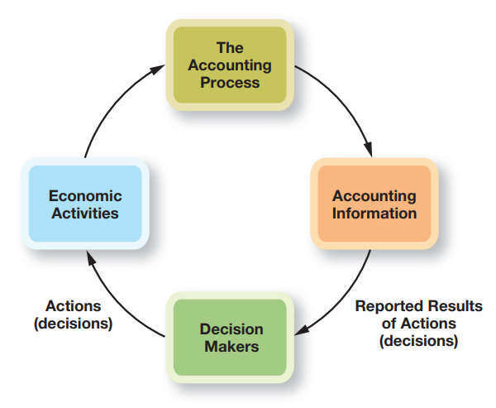
The following figures, illustrates how economic activities flow into the accounting process. The accounting process produces accounting information used by decision makers in making economic decisions and taking specific actions. These decisions and actions result in economic activities that continue the cycle.

Slide 16
Types of Accounting Information
Financial accounting involves recording and clarifying business transactions along with preparation and presentation of financial statements. Financial accounting follows GAAP principles and focuses on historical data. For example, a financial accountant may analyze the financial records of the previous quarter to make recommendations for changes in the next quarter.
Financial accounting information is designed primarily to assist investors and creditors in deciding where to place their scarce investment resources.
Financial accounting information also is used by managers and in income tax returns. In fact, financial accounting information is used for so many different purposes that it often is called “general-purpose” accounting information.

Slide 17
Contd.
2. Management accounting
Management (or managerial) accounting involves the development and interpretation of accounting information intended specifically to assist management in operating the business. Managers use this information in setting the company’s overall goals, evaluating the performance of departments and individuals, deciding whether to introduce a new line of products, and making virtually all types of managerial decisions.
For example, they need to know the amount of money in the company’s bank accounts; the types, quantities, and dollar amounts of merchandise in the company’s warehouse; and the amounts owed to specific creditors.

Slide 18
Contd.
Tax Accounting
The preparation of income tax returns is a specialized field within accounting. To a great extent, tax returns are based on financial accounting information. However, the information often is adjusted or reorganized to conform with income tax reporting requirements.
Although tax information is important for a company’s successful operations and is related to financial and management accounting information, it results from a different system and complies with specialized legal requirements that relate to a company’s responsibility to pay an appropriate amount of taxes.
Laws and regulations governing taxation are often different from those underlying the preparation of financial and management accounting information, so it should not be a surprise that the resulting figures and reports are different.

Slide 19
Who Uses Accounting Data?
The Financial information that users need depends upon the kinds of decisions they make. There are two broad groups of users of financial information: internal users and external users.
Internal Users:
Internal users of accounting information are managers who plan, organize, and run the business. These include marketing managers, production supervisors, finance directors, and company officers.

Slide 20
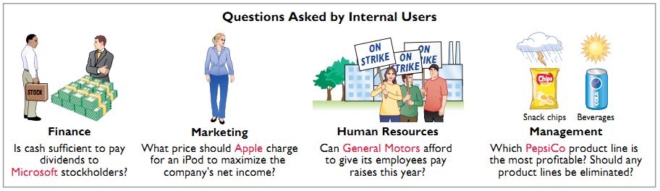
Illustration 1.2: Questions that internal users ask

Slide 21
EXTERNAL USERS
External users are individuals and organizations outside a company who want financial information about the company.
The two most common types of external users are investors and creditors. Investors (owners) use accounting information to decide whether to buy, hold, or sell ownership shares of a company.
Creditors (such as suppliers and bankers) use accounting information to evaluate the risks of granting credit or lending money.

Slide 22
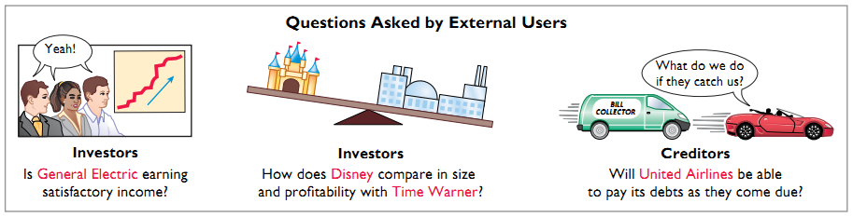
Illustration 1.3 Questions that external users ask

Slide 23
Why Accounting?/Motivation behind accounting
Studying accounting as a software engineering or computer science student offers several benefits that can enhance your career and technical skills:
Understanding Business Operations: Accounting provides insights into how businesses operate financially. This knowledge can help you understand the financial implications of the software solutions you develop, making you better equipped to design systems that align with business needs.
Financial Literacy: Being financially literate allows you to make informed decisions, both in personal finance and within a business context. Whether you’re managing a startup, working in a tech company, or considering investments, understanding accounting principles will help you make sound financial decisions.
Efficient Decision-Making: Accounting teaches you how to analyze financial data, which can improve your decision-making skills. This is valuable when managing projects, budgeting for resources, or evaluating the financial viability of new technologies.

Slide 24
Contd.
Interdisciplinary Collaboration: In many tech companies, you'll work closely with finance teams. Understanding accounting can improve communication and collaboration, as you’ll be better able to understand their concerns and contributions to projects.
Software Development in Finance: If you’re developing software for financial applications, such as accounting software, payment systems, or financial analysis tools, a background in accounting will help you better understand the requirements and challenges of these domains.
Fintech (Financial Technology): Accounting knowledge can open doors to careers in financial technology (fintech), data analysis, and other fields where understanding both technology and finance is essential.
FYP: This course will help you if you take on a final year project in area of accounting.

